Slide 1
Business in Practice: Data Analytics Week 10
Dr. Markos Kyritsis

Slide 2

Learning outcomes
This week we will look at multiple linear regression. By the end of the week you should be able to:
Create linear models with more that one predictor
Interpret the output of the linear models
Explain why significant variables sometimes stop being significant (mediation)
Identify one method to control overparametrisation (won’t be asked to do it in the assessment)

Slide 3
Multiple linear regression
It’s one extra step (if even) when using software, making it quite trivial to add more than one predictor in the model.
Let’s use the Salaries dataset for this one

Slide 4
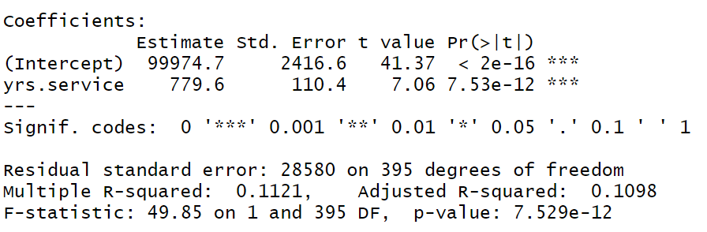
But first, let’s create two models (this is to help you understand a later point)
Let’s start with the first simple linear regression:
Salary ~ years of service
Significant predictor

Slide 5
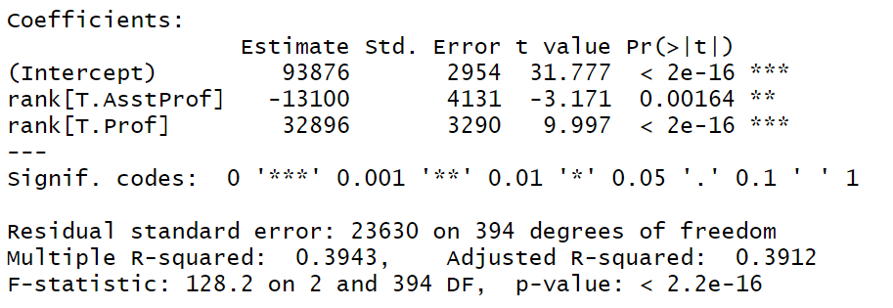
Second model
Salary ~ rank
Significant predictor

Slide 6
Let’s think about this…
Independently, both variables are significant predictors of salary, so, surely, if we can combine them we can explain more of the variance in salary, right?
In theory, that makes sense. By doing that we can get y-hat closer to those y values. However, in practice that doesn’t always work out.
Let’s see what happens.

Slide 7
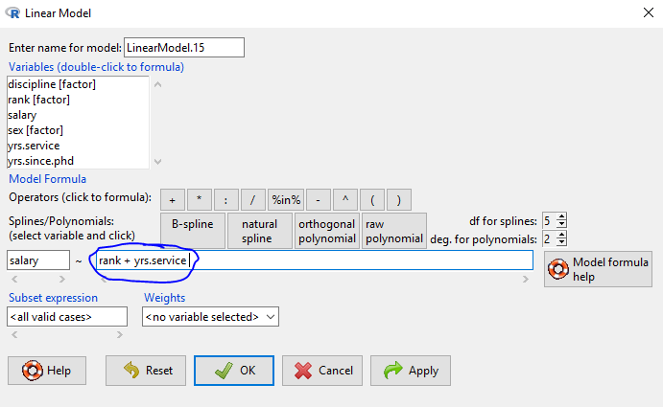
Multiple linear regression

Slide 8
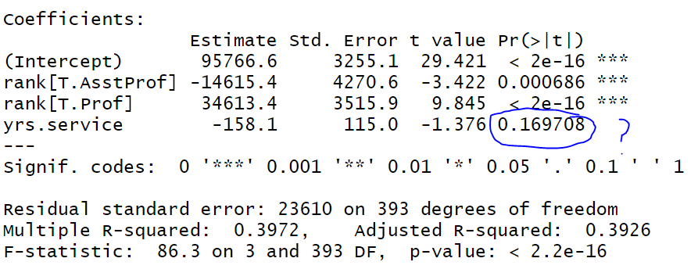
Output

Slide 9
Explanation
So why did the significant effect disappear?
Because of mediation effects. It’s not actually years of service that has an effect on salary, it’s actually years of service that has an effect on rank, which in turn has an effect on salary!
In other words, people are more likely to increase in ranks as time goes by. The salary is dictated by rank. So someone who rises in the ranks quickly will start making more money.

Slide 10
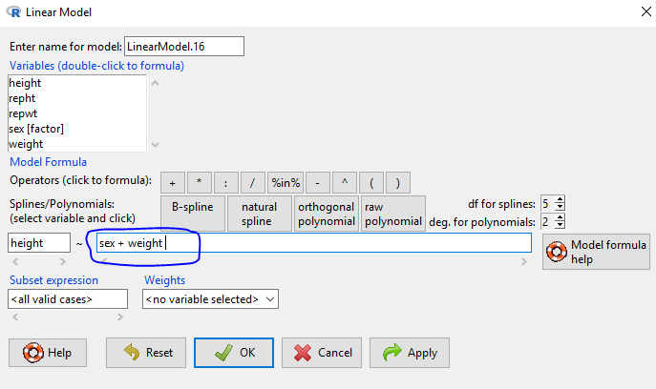
Now for a model that actually works (Davis dataset)

Slide 11
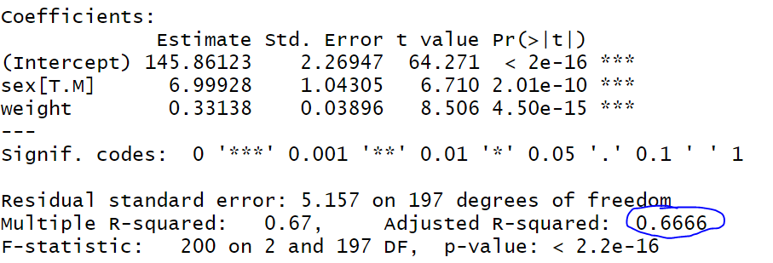
Results

Slide 12
Test the model on unseen data
Like before, but this time we take the linear combination of variables.
I’m 104kg, I’m also a male, so according to the model: 145.86 + 7.0 + 0.33138*104 = 187.3235cm
My actual height is 183cm. Again, not quite, but oh well.

Slide 13
Reporting the model
We report everything exactly the same way as before (when we did simple linear regression), even the coefficients. The only difference is that we report adjusted R-squared rather than multiple R-squared *
Notes:
*If you’re wondering why, it’s because the R2 formula is susceptible to becoming artificially inflated when we add more predictors, even if they are garbage. A penalty term is introduced to control for this. More needs to be done however…

Slide 14
Stepwise regression
In reality we usually create full models with large amounts of predictors. We then reduce the models to their most ‘significant’ predictors by applying a penalty term.
One of the methods is using stepwise regression.
Penalty terms for stepwise regression are BIC and AIC.
I’m not really going to talk about this, as it doesn’t come up in your assessment. However, I’ll discuss it briefly in the seminar and give you a paper to read (optional).

Slide 15
Diagnostic plots
Same as last week.

Slide 16
Summary
By taking the linear combination of variables we can create a linear model with more than one predictor
We can use categorical and numerical predictors
Mediation effects can render predictors non-significant
We can apply models on previously unseen data quite easily, even manually (see slide 12)
We report the model in the same way as we did last week. Just remember to report adjusted R-squared
Overparametrisation can be controlled using stepwise regression (advanced topic not required for the assessment)

